Slide 1

Interview Presentation
Osura Weerasinghe

Slide 2
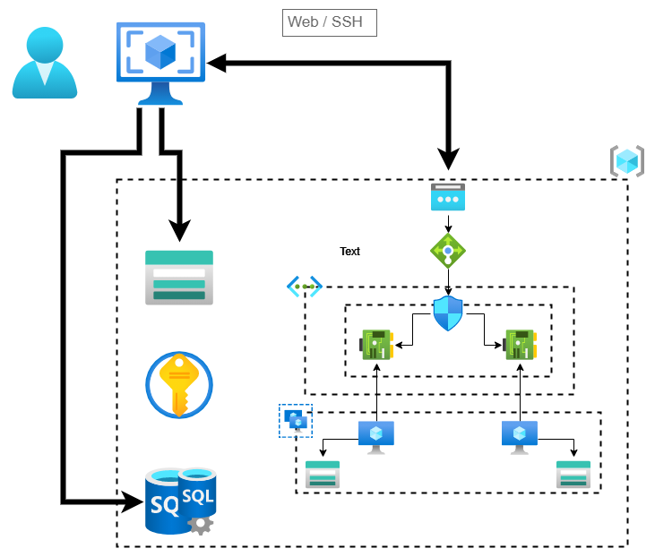


Slide 3

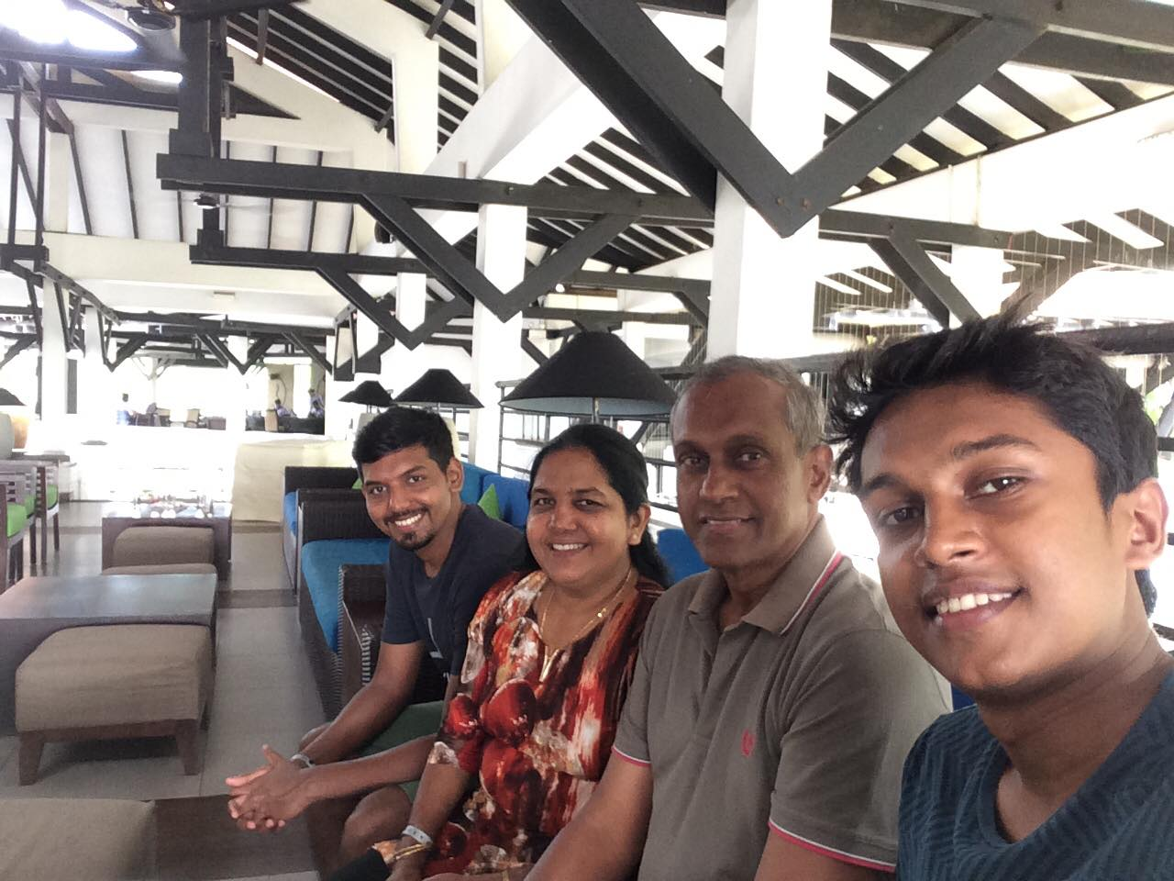

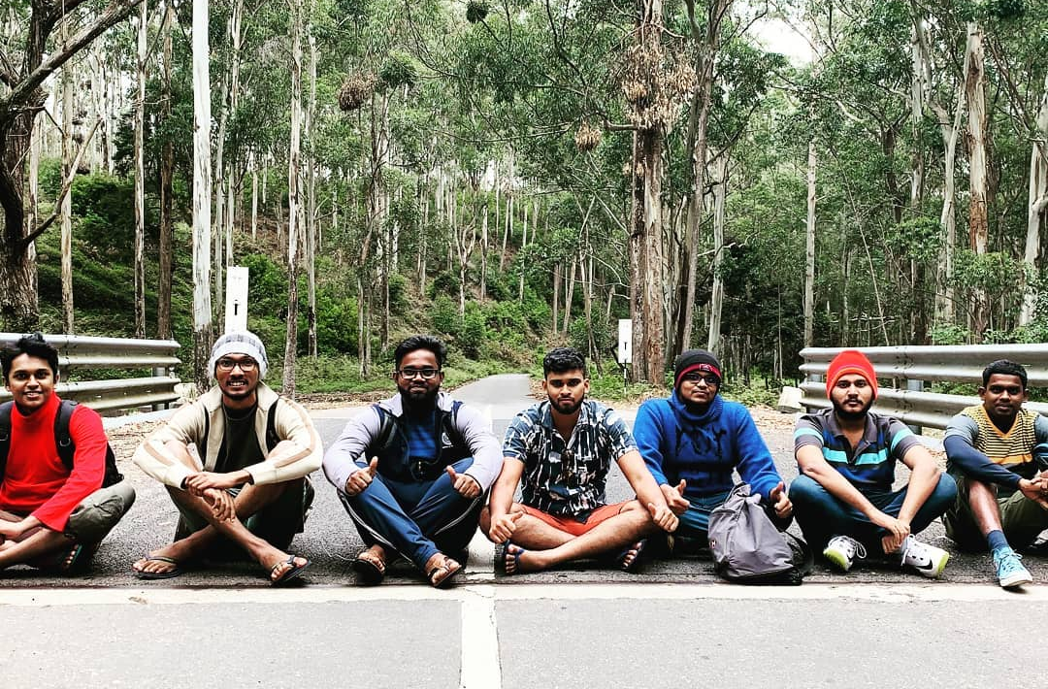

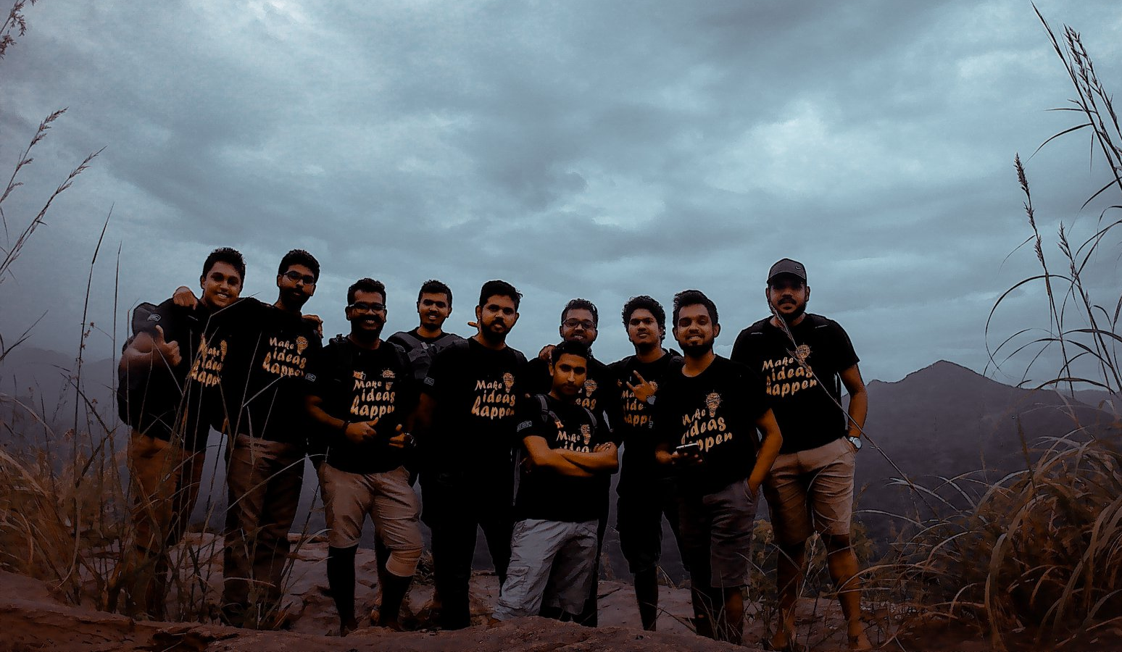

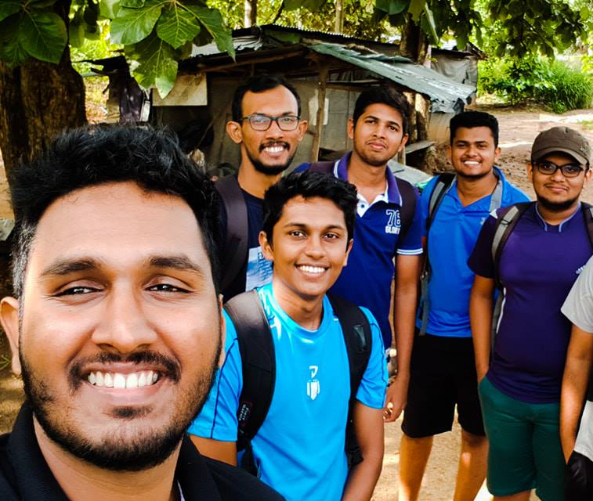



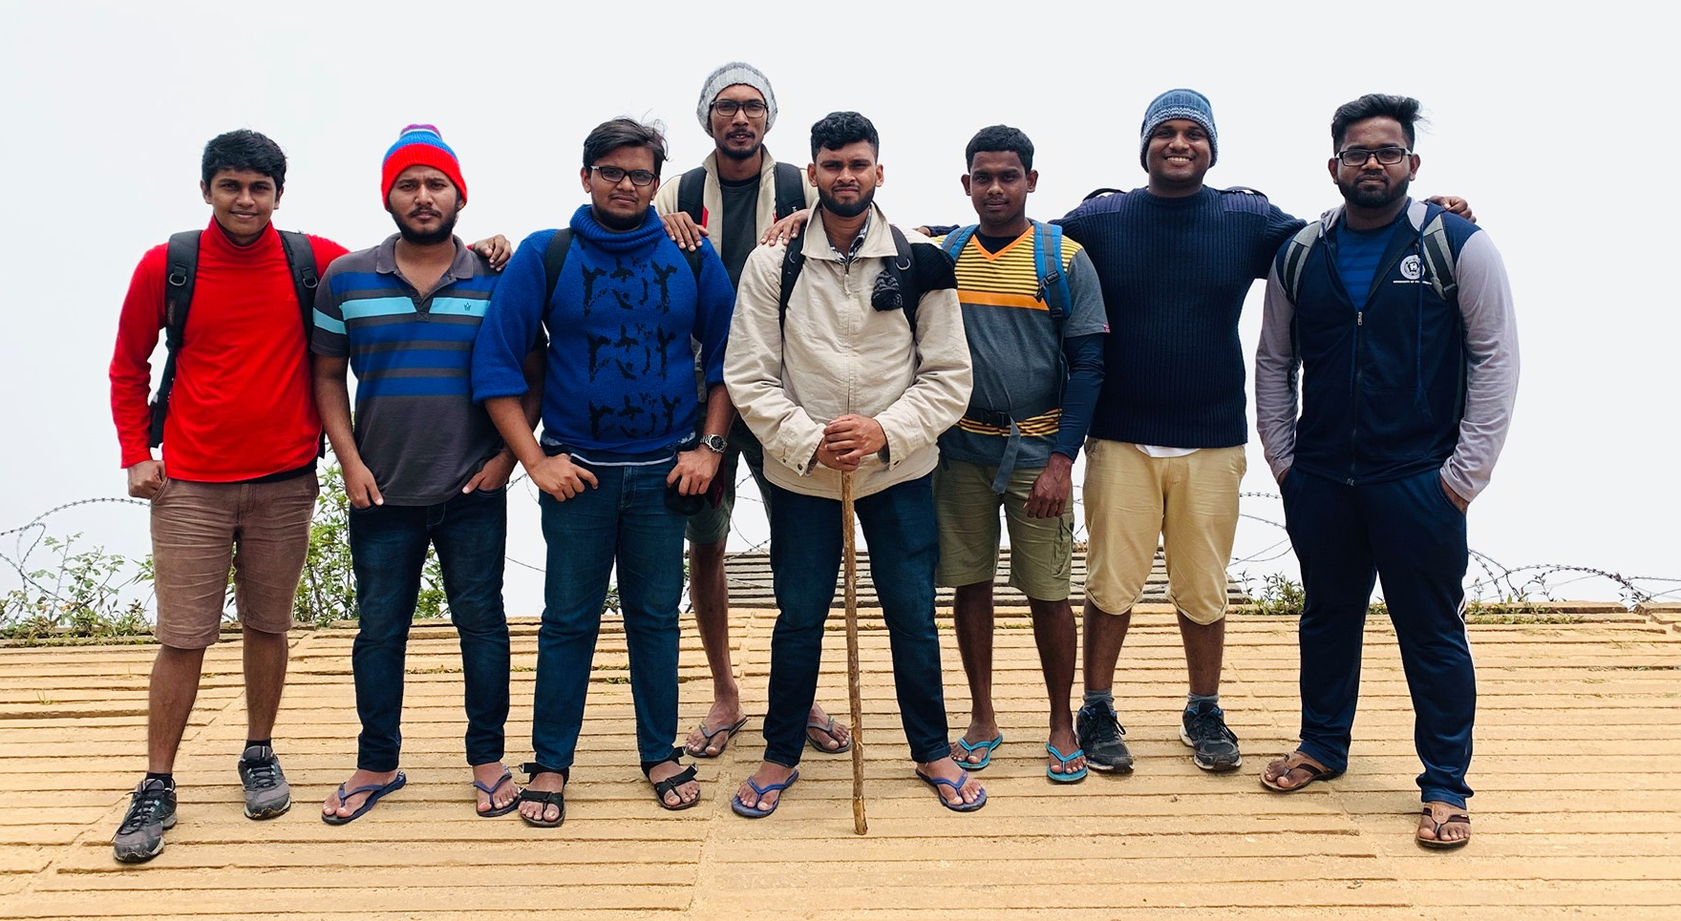

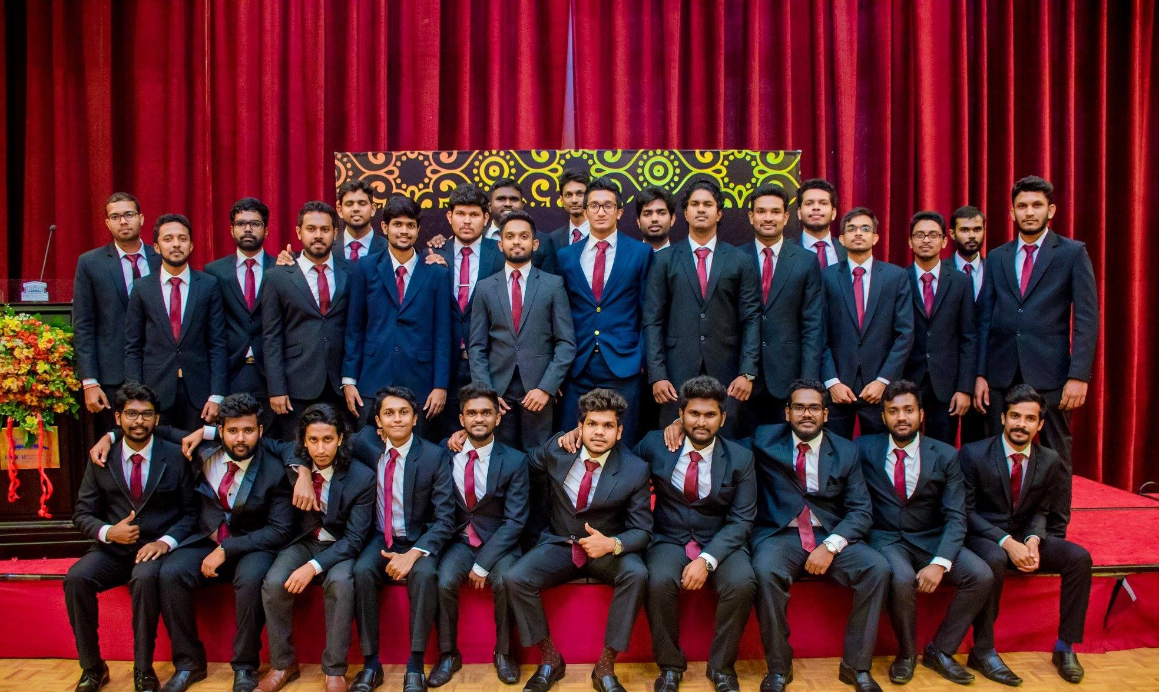

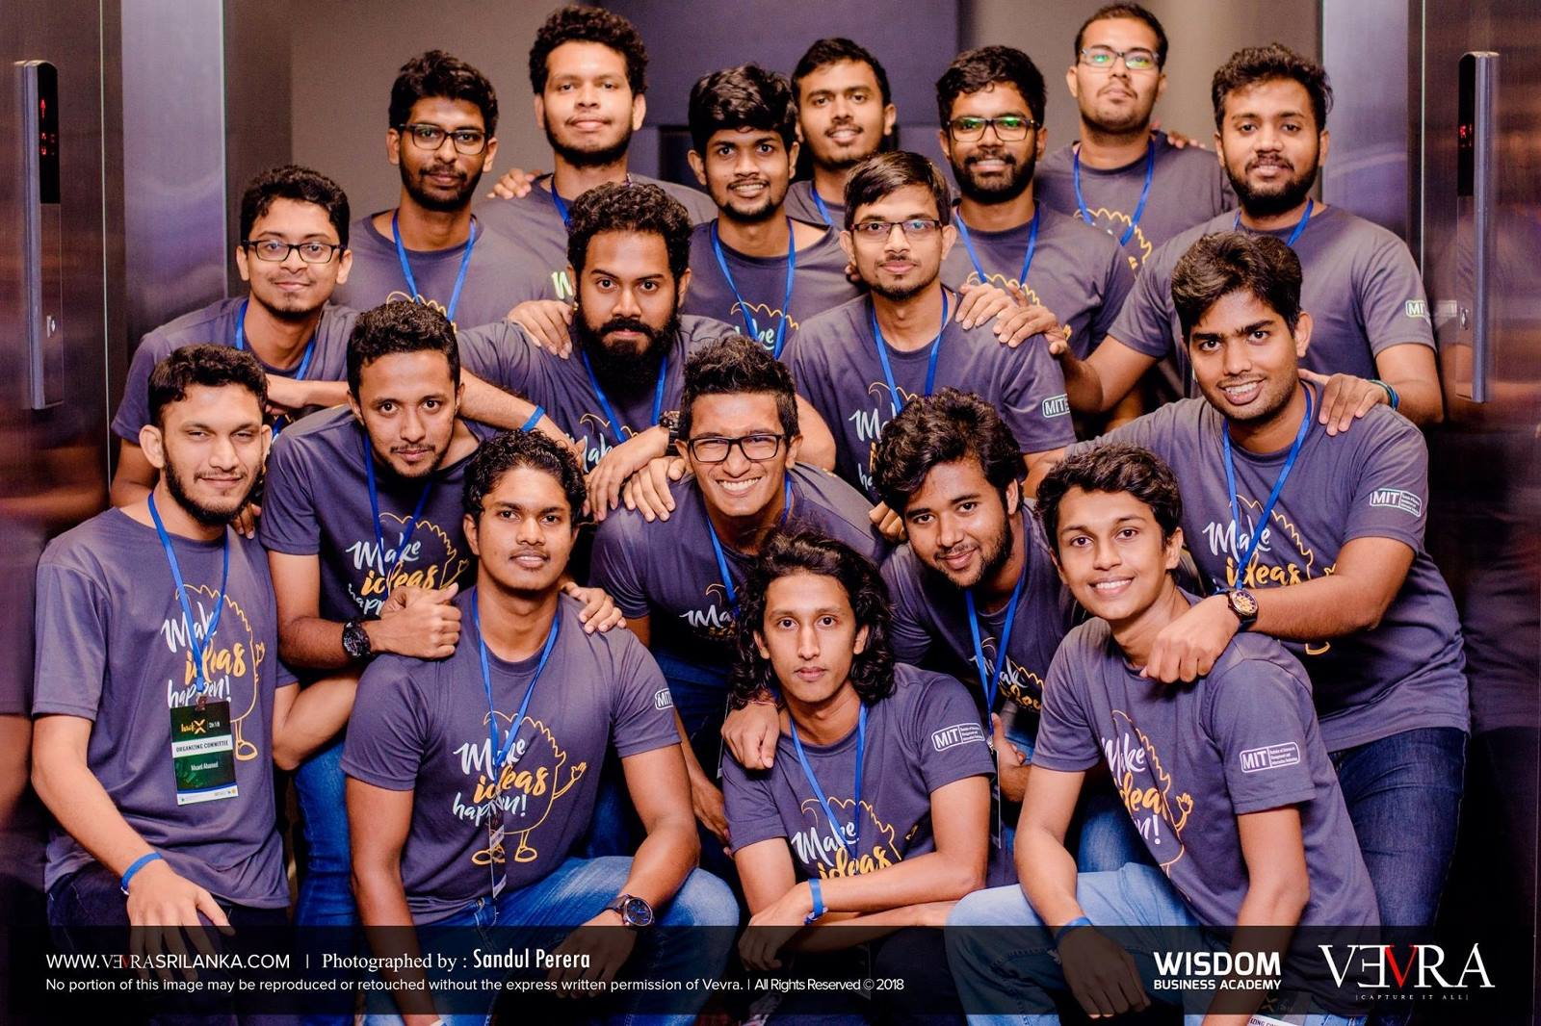



Slide 4


Slide 5
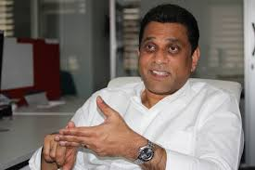



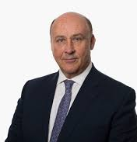
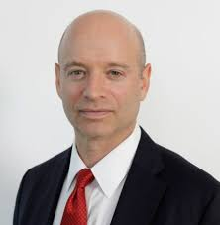


Establish In 2007
Public limited company
Previously named as MillenniumIT
2.9 billion revenue in 2019
Headquarters In UK
Financial services
Establish In 1801
Founder, Mr. Tony Weerasinghe
Electronic trading platform
3 consecutive time world's best
Millennium Exchange
Chairman
Mr. Don Robert
London Stock Exchange
Linux-based system
126 microsecond trading time
Chief Executive Officer
Mr. David Schwimmer
Sub-millisecond latency
Used by,
Oslo Stock Exchange,
Johannesburg Stock Exchange,
Borsa Italiana, ….
USD $26 billion Market capitalization
TradElect, .Net based electronic trading platform, 2007-2011
Investment management company
Stock Exchange in Italy

Slide 6
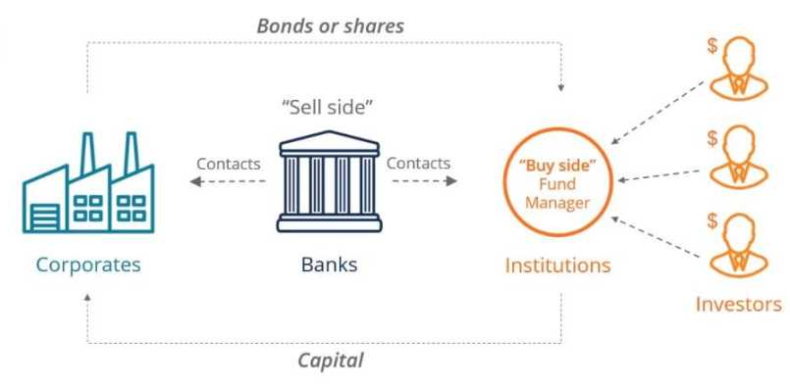
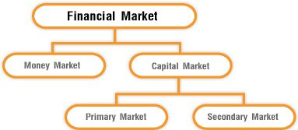
Capital Markets

Slide 7
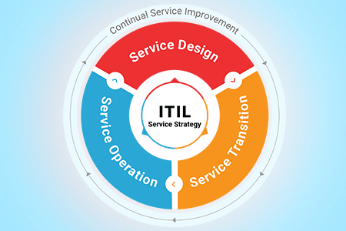
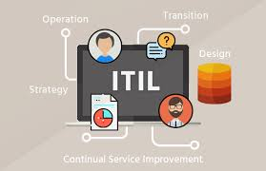
Information Technology Infrastructure Library
Best practice framework
Individual can certify
Related to Areas such,
IT service management processes
IT service support processes
IT Service Delivery Processes.
Process use ITIL
IT Service support processes
Incident Management
Configuration Management
Release Management
ISO 20000 a similar standard

Slide 8
Application Support Engineer / DevOps Engineer
Application Support Engineers
Provides and manage infrastructure for running service.
Monitor and analyze running service performance and take corrective actions.
Ensure optimal service level between inter-connected services.
Provide support for both customers and internal user's base on request.
Provisioned and maintain different execution environments.
DevOps Engineers
Manage processes related to Continuous Integration/Delivery/Deployment.
Build CI/CD pipelines that deliver frequent software functionalities.
Automate repetitive / time taking / complex process to achieve fast / less error / guarantied outputs.

Slide 9
Why I want to works as an Application Support Engineer / DevOps Engineer
Because I like it.
Evolving area in IT industry
Ability to work in both programming and infrastructure related area
Challenging and problem solving.
Gives the ability to work with different technologies.
Likeness and knowledge in computer networking.
Skills in troubleshooting and fixing things.
Not good at front-end development.

